Slide 1
LANGUAGE IDENTIFICATION SYSTEM
Name: Gitari Collins Munene
Adm No: 110062748
Unit: CSC 423

Slide 2
INTRODUCTION
Language identification is a task in NLP
It determines the language of a text
This project focuses on:
- English
- Swahili
- Kikuyu
- Sheng
It also handles mixed language

Slide 3
Objectives
Build a language classification system that can predict:
English
Swahili
Kikuyu
Sheng
Mixed
Correct labeling of languages
Apply preprocessing techniques
Apply feature extraction to my system
Train the system
Evaluate system’s accuracy, precission ,f1 score etc.
Build and deploy a working application

Slide 4
DATA COLLECTION
The Dataset was created using real-world language patterns
The sources were inspired by :
Social media posts and comments like Facebook and twitter and Instagram
Online articles like BBC news Swahili
SMS/text communication
Hymn books for KIkuyu
1000+ sentences (250 per language)
The languages are :
English (250)
Swahili (250)
Kikuyu (250)
Sheng (250)
I used a simple data augmentation approach by generating variations of existing sentences. This included replacing words, mixing languages, and restructuring sentences to create more diverse training examples.

Slide 5
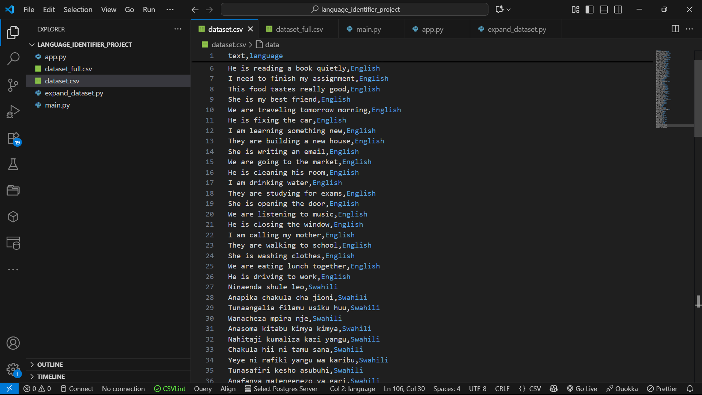
DATA LABELLING
Each sentence in the project is labeled with its language
Examples:
"I am going" → English
"Ninaenda shule" → Swahili
"Niko base" → Sheng
"Ningi thii" → Kikuyu
.

Slide 6
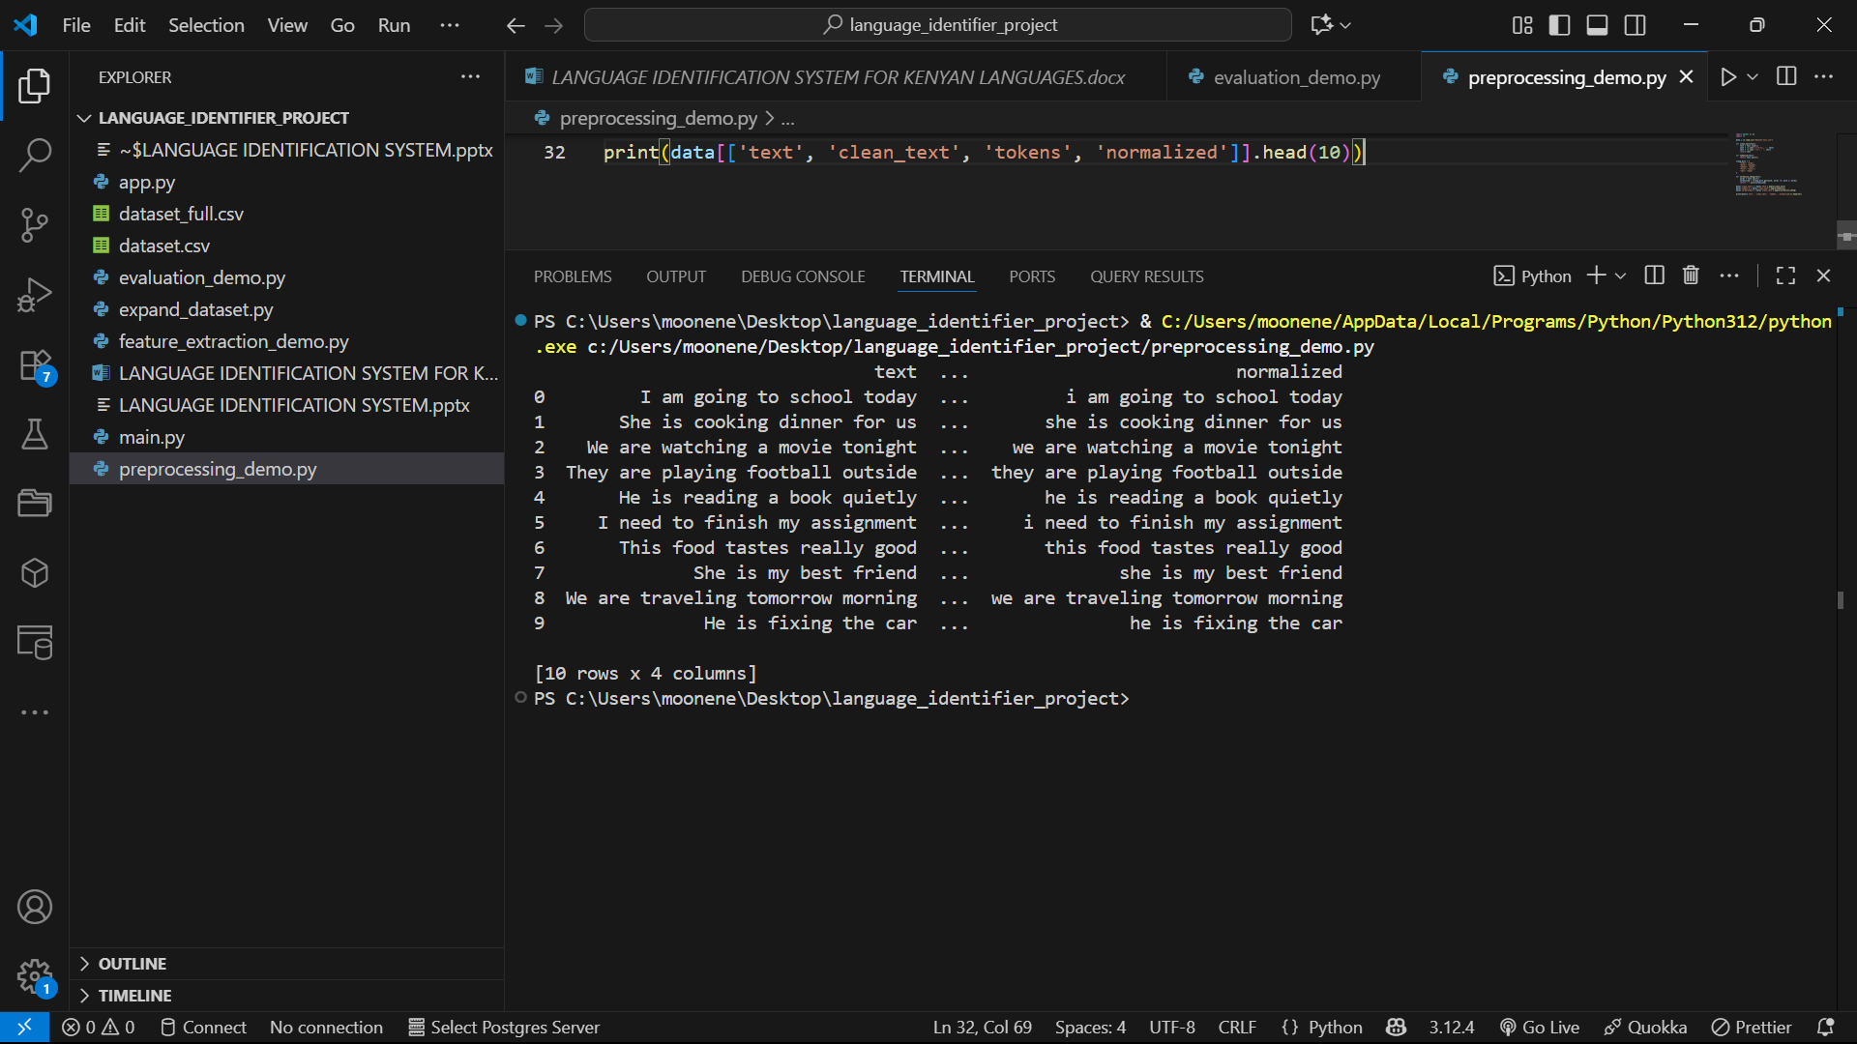
DATA PROCESSING
I have implemented the following data processing functions in the project:
Lowercasing text
Removing punctuation
Removing extra spaces
Tokenization
Sheng slang normalization

Slide 7
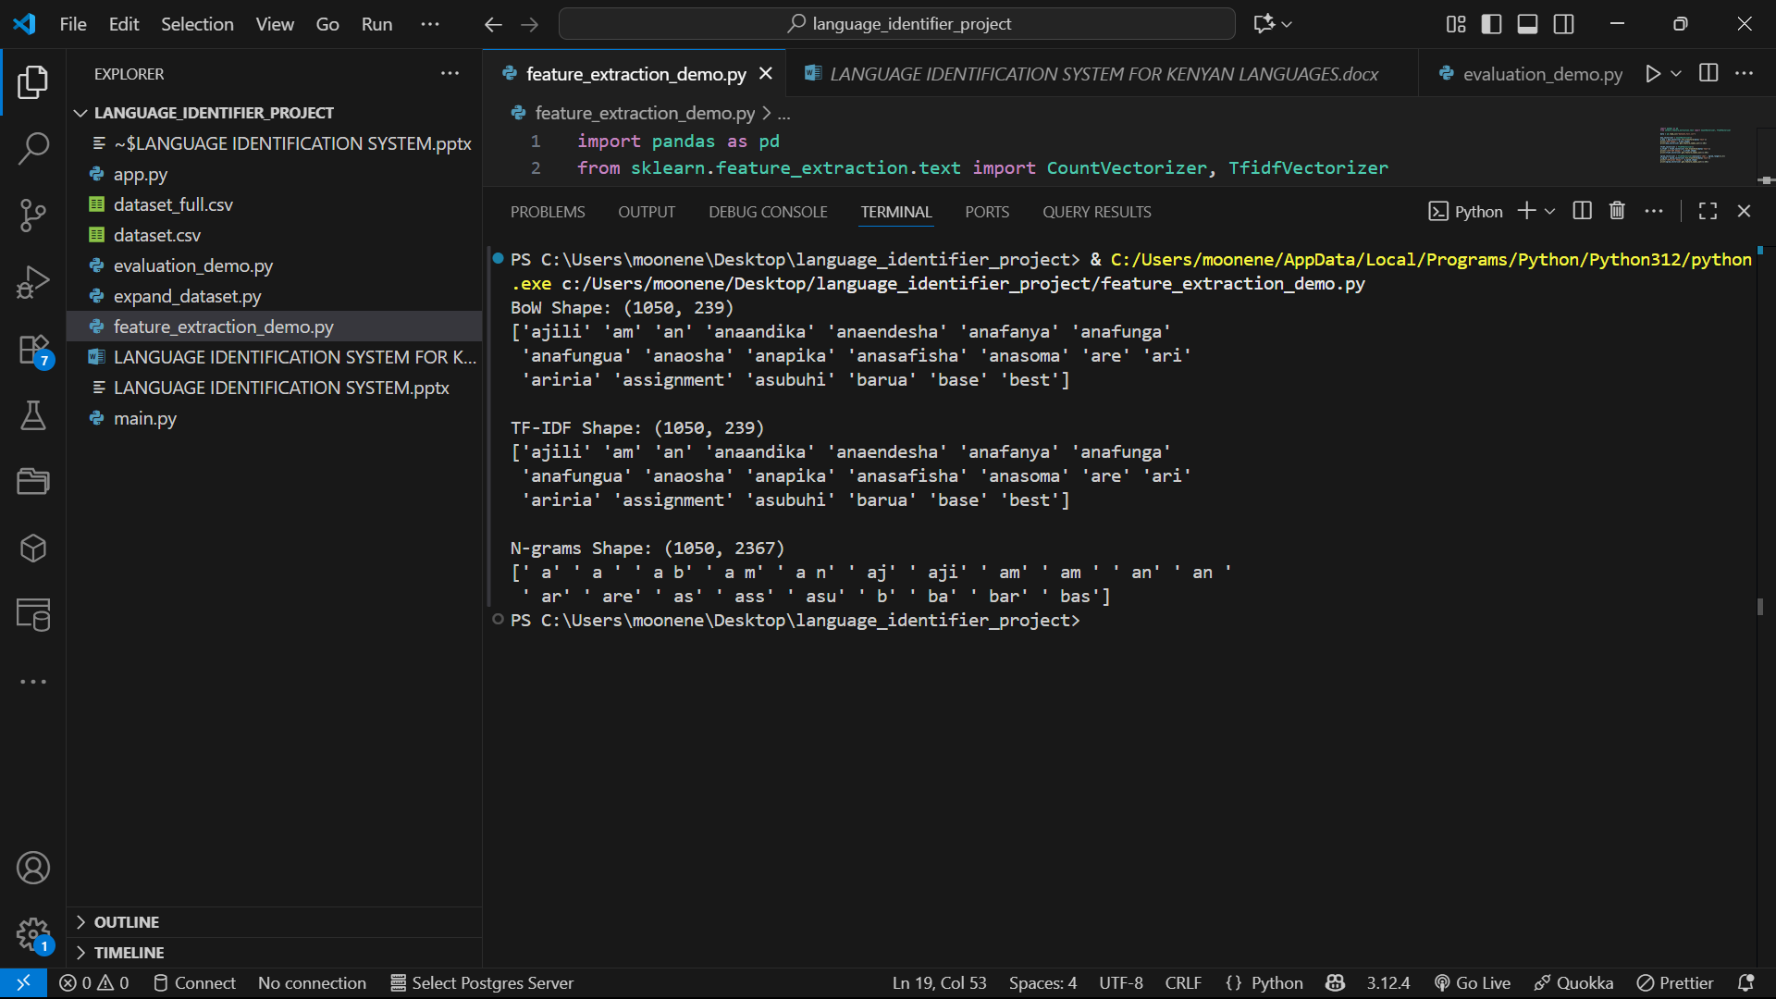
FEATURE EXTRACTION
For this project I implemented Bag of Words, TF-IDF, and Character n-grams. Character n-grams performed best.
The reason for using it is because it can:
Capture spelling patterns
Understand language specific structures
It is also robust to spelling and slang variations

Slide 8
Model evaluation
In the project I have used the Naïve Bayes and Logistic Regression to compare the projects performance
All metrics are close to 1.0 for logistic regression indicating very high performance in logistic regression.
But in real life scenarios because of difference in language usage, the accuracy might reduce based on the sentences used like too much mixed sentences, complex sheng words etc
Although both models performed similarly, I selected Logistic Regression because it provides more stable predictions and better handles feature relationships

Slide 9
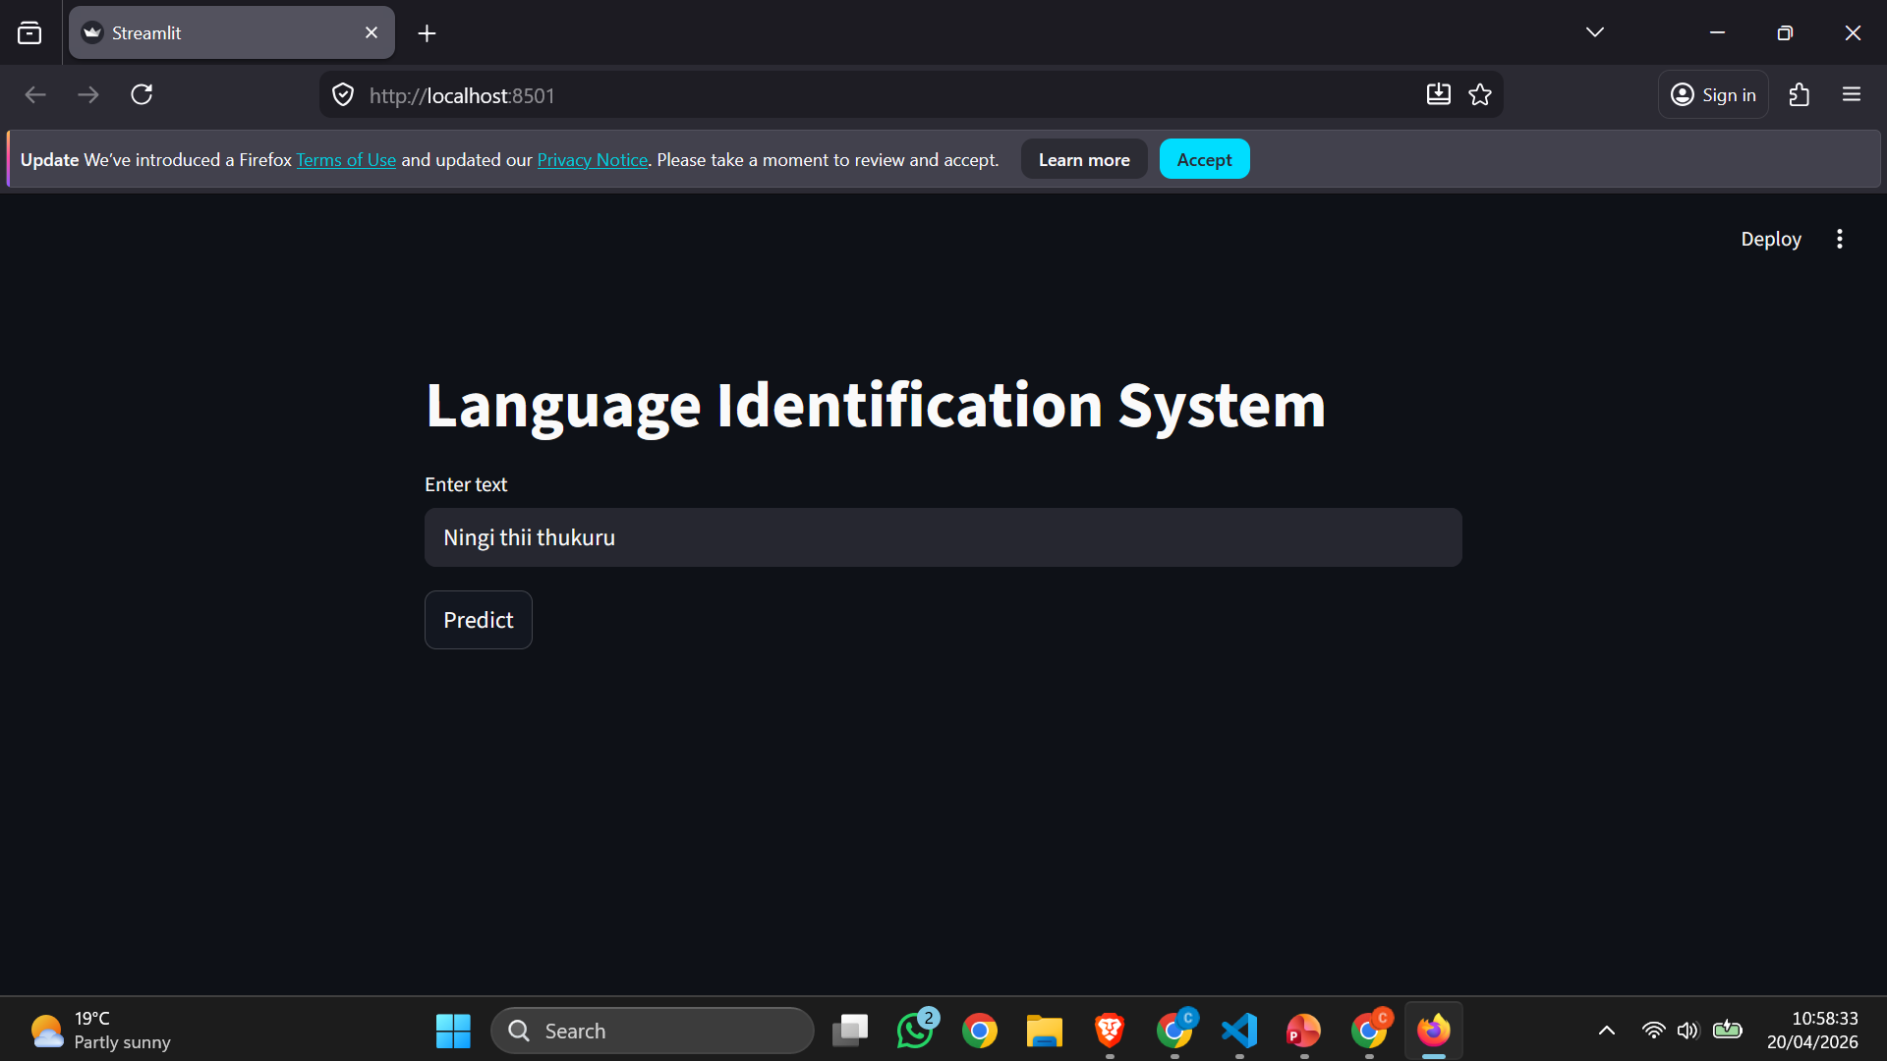
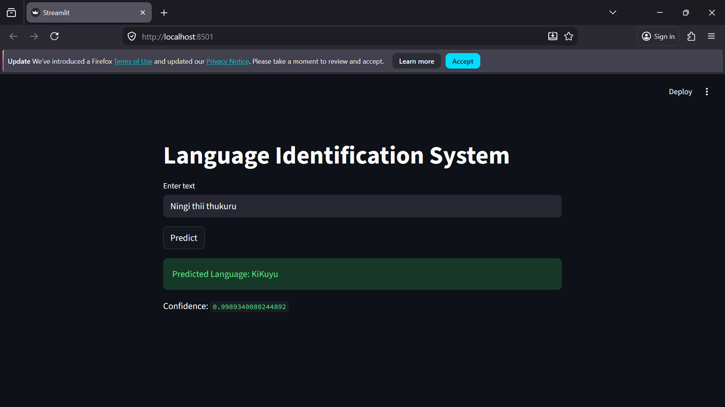
APP demo
The app is deployed using Streamlit.
How does it work:
User:
- Enters text
- Clicks Predict
System outputs:
- Language
- Confidence score

Slide 10
Handling Mixed Language
I introduced a mixed class in the project that can handle a mixed sentence of both English and Swahili or Sheng and Kikuyu
The model is trained using some mixed language examples
Example: I am going tao sasa System detects mixed language usage
Adding mixed language handling Improves real-world performance

Slide 11
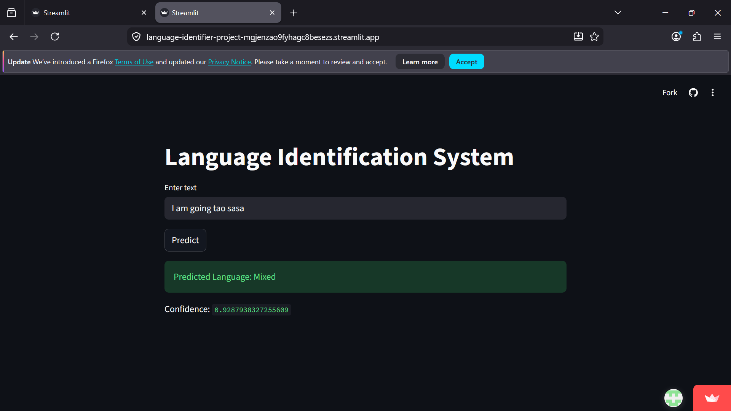

Slide 12
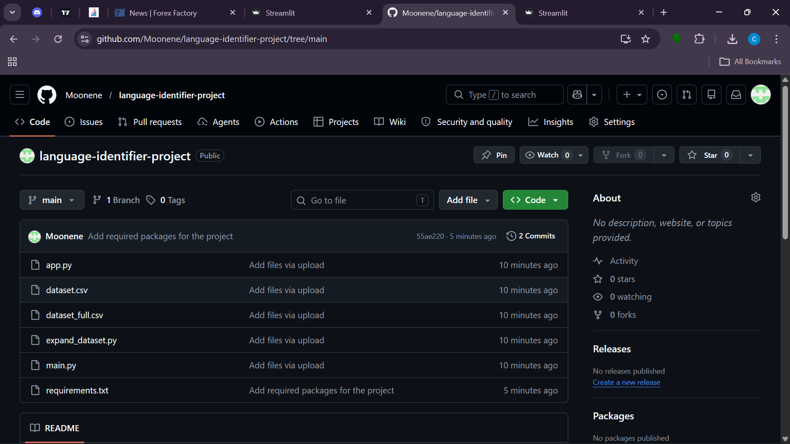
Online deployment
The system was deployed using Streamlit
Link to page: https://language-identifier-project-mgjenzao9fyhagc8besezs.streamlit.app/
Cloud and the application is hosted on Github
Link to Github: https://github.com/Moonene/language-identifier-project
With the link above it is accessible through a web browser and no installation is required for users

Slide 13
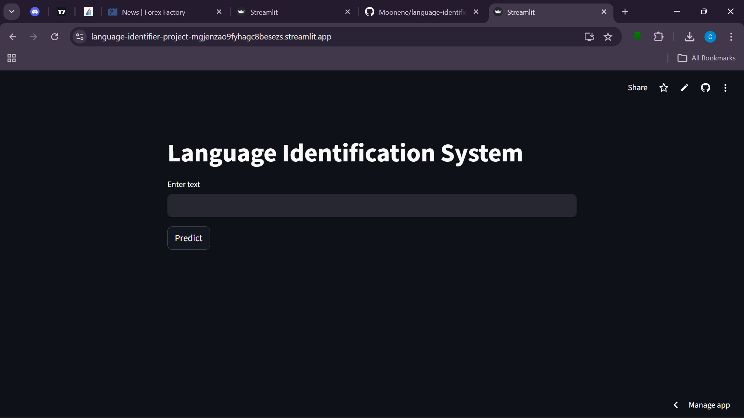
LIVE app on streamlit

Slide 14
limitations
Performance may drop on very short text
Unseen slang or new Sheng words may affect accuracy
Dataset was manually created and may not cover all real-world variations
Model may struggle with complex mixed-language sentences
Limited to four main languages
Re-used sentences making the system accuracy to be high yet it is lower than that

